Slide 1
Advanced Understanding of Statistical Models for ML
Kevin Ford
kevinf@magenic.com
617 359-5192

Slide 2
https://github.com/Magenic/MMLStatisticalModelsForML
https://www.amazon.com/Machine-Learning-Absolute-Beginners-Introduction-ebook/dp/B07335JNW1?ie=UTF8&redirect=true&ref_=ku_mi_rw_edp

Slide 3
Focus of Class – Model Shapes and Hyper Parameters
What optimizer should I use?
Activation Function?
Kernel (weights)?
How to handle bias?
How many layers?
Layer type?
How many neurons?
How many epochs?
What are the different loss functions?
Batch size?

Slide 4
What is a Gaussian (Normal) Distribution
But what if our data does not use a normal distribution?
Based on X-Y data relationship
Data normally “assumed” to have a normal distribution
New data can be seen to “belong” based on standard deviations

Slide 5
Regressions – normal or not?
Notes:
Q: When we take data and alter it before machine learning like with did with the COVID data, what were we doing and why did it work?
A: We were altering the relationships between the independent and dependent variables to create a relationship with a normal distribution

Slide 6
Is My Data Normal?
import pandas as pd
my_data = pd.Series([1, 2, 3, 4, 5, 6, 7, 8, 9, 10, 8, 6, 4, 2])
my_data.hist()

Slide 7
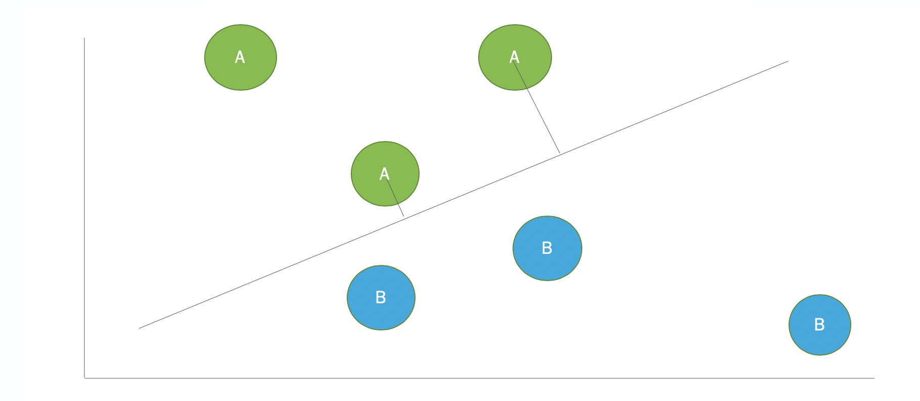
Loss functions (Cost Function)
A number representing how close the predicted values are to actual values
The numbers are not easily comparable to different models or loss functions
In general a goal it so minimize the loss
Size of loss impacts the amount weights are changed
Specifying the loss function
Loss
model.compile(optimizer=‘adam', loss='mse')

Slide 8
Some Common Loss Functions
Functions for regressions
Mean Squared Error
Mean Squared Logarithmic Error
Mean Absolute Error
Functions for binary classifications
Binary Cross-Entropy
Hinge
Squared Hinge
Functions for non-binary classifications
Multiclass Cross-Entropy
Sparse Multiclass Cross-Entropy
Kullback Leibler Divergence

Slide 9
Regression Loss
MSE – Mean Squared Error (Default)
MSE is thus good to use if you believe that your target data, conditioned on the input, is normally distributed around a mean value, and when it’s important to penalize outliers extra much.
MSLE – Mean Squared Logarithmic Error
Use MSLE when the input is normally distributed, and you don’t want large errors to be significantly more penalized than small ones, in those cases where the range of the target value is large.
MAE – Mean Absolute Error
Use Mean absolute error when you are doing regression and don’t want outliers to play a big role. It can also be useful if you know that your distribution is multimodal, and it’s desirable to have predictions at one of the modes, rather than at the mean of them.

Slide 10
Demo 1: Experimenting with regression loss

Slide 11
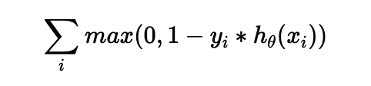
Binary Classification Loss
binary_crossentropy – (Default)
The loss function binary crossentropy is used on yes/no decisions, e.g., multi-label classification. The loss tells you how wrong your model’s predictions are.
hinge – Hinge
Use when accuracy is very important. The function strongly penalizes wrong guesses and uncertainty during training. Can lead to sparcity.
squared_hinge – Squared Hinge
Use the Squared Hinge loss function on problems involving yes/no (binary) decisions and when you’re not interested in knowing how certain the classifier is about the classification (i.e., when you don’t care about the classification probabilities).

Slide 12
Demo 2: Experimenting with regression loss

Slide 13
Sparse vs One Hot Encoding
Sparse metric:
[4, 3, 4, 1, 2]
One Hot encoded metric
[[0,0,0,1],[0,0,1,0],[0,0,0,1],[1,0,0,0],[0,1,0,0]]
Different loss functions assume a different structure of the data

Slide 14
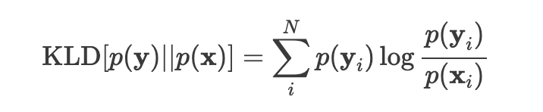
Non-Binary Classification Loss
categorical_crossentropy – Multiclass Cross-Entropy
Use when there are several options in the dependent training data and only one can be correct (hot coded data)
sparse_categorical_crossentropy – Sparse Multiclass Cross-Entropy
Use in the same situations as Multiclass Cross-Entropy but when the dependent training data is sparse
KLDivergence – Kullback Leibler Divergence
For normal non-binary classification loss, Kullback Leibler Divergence is functionally identical to Multiclass Cross-Entropy. More commonly used when using models that learn to approximate a more complex function than simply multi-class classification.

Slide 15
Demo 3: Experimenting with regression loss

Slide 16
Homework reading
https://towardsdatascience.com/what-if-your-data-is-not-normal-d7293f7b8f0
https://towardsdatascience.com/6-ways-to-test-for-a-normal-distribution-which-one-to-use-9dcf47d8fa93
https://machinelearningmastery.com/how-to-choose-loss-functions-when-training-deep-learning-neural-networks/
Book Chapter 8 – Part 2: Understanding the Mathematical Functions Used
Create perception given in example in the readings

Slide 17
Q & A
New week – optimizing our model

